Slide 1
K-Means Clustering
Deepayan Chakrabarti (deepay@utexas.edu)

Slide 2
Clustering
Given a large number of training points
find groups or clusters of points
Main difference from classification:
In classification we have the class labels
X = features of data points
y = labels of those points (0 or 1)
In clustering, we have no class labels
Only X

Slide 3
Clustering
In classification
X = data features are given
y = class labels provide supervision
The user says “These are the true labels”
Classification is also known as Supervised Learning
In clustering
Only X, no y ➔ no human supervision
Clustering is also called Unsupervised Learning

Slide 4
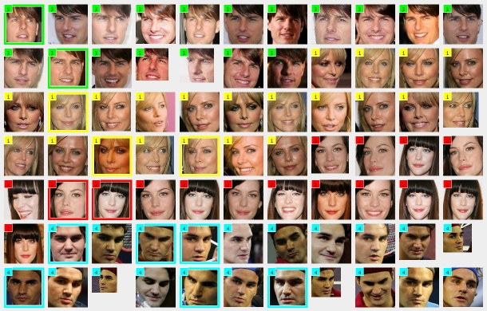
Clustering
Given X, find groups/clusters of similar items
Image
clusters
X = image features
http://www.ulrichpaquet.com/prente/face_clustering.jpg

Slide 5

Clustering
Given X, find groups/clusters of similar items
Document clusters
X = features of news article
http://news.google.com

Slide 6
Clustering
The main goal of clustering is data exploration
“What types of faces exist?”
“Can we distinguish different types of news stories?”
“Are there several distinct categories of credit card users?”
Once we have the clusters, we can
just look at the clusters to interpret them and gain understanding
use the cluster of each data point as an extra feature for that data point
for further classification tasks
Notes:
Common use: clusters of complaints

Slide 7
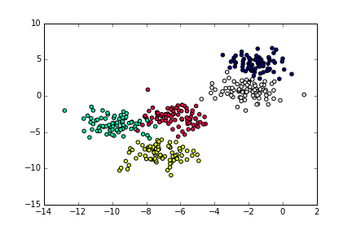
Clustering
Feature 2
X = (feature1, feature2)
for each data point
How can we find the clusters?
Feature 1
Data points from five clusters

Slide 8
K-Means clustering
How can we find the clusters?
Let’s start with a more basic question
If I told you the clusters, and gave you a new point, which cluster should this point belong to?
New point

Slide 9
K-Means clustering
“Closest point to the new point is white ➔ white cluster”
but what if the closest point happens to be an outlier of its cluster?
Safer option:
“Closest cluster center to the new point is white ➔ white cluster”
New point

Slide 10
K-Means clustering
“Closest cluster center to the new point is white ➔ white cluster”
Associates a cluster with its “center”
What is the center?
Picks closest center
How do we calculate distances?

Slide 11
K-Means clustering
“Closest cluster center to the new point is white ➔ white cluster”
Associates a cluster with its “center”
What is the center?
K-Means: Average of the features of all points in the cluster

Slide 12

K-Means clustering
“Closest cluster center to the new point is white ➔ white cluster”
Picks closest center
How do we calculate distances?
K-Means: Euclidean distance
x
A
Feature 2
y
B
Feature 1
Distance between A and B =

Slide 13
K-Means clustering
“Closest cluster center to the new point is white ➔ white cluster”
Associates a cluster with its “center”
What is the center?
K-Means: Average of the features of all points in the cluster
Picks closest center
How do we calculate distances?
K-Means: Euclidean distance
New point
New point is closest to the green cluster center ➔ assign to green cluster

Slide 14
K-Means clustering
10
10
9
9
8
8
7
7
6
6
5
Assign each objects to most similar center
5
4
Update the cluster means
4
3
3
2
2
1
1
0
0
0
1
2
3
4
5
6
7
8
9
10
0
1
2
3
4
5
6
7
8
9
10
reassign
reassign
Randomly initialized “cluster centers”
Points change clusters
K=2
Arbitrarily choose K points as initial cluster centers
Update the cluster means
[Qiang Yang]

Slide 15
K-Means clustering
Start with random cluster centers
Assign points to closest cluster center
Everyone assigned to the same center is one cluster
Re-compute center for each cluster
Repeat from step 2 onwards until convergence

Slide 16
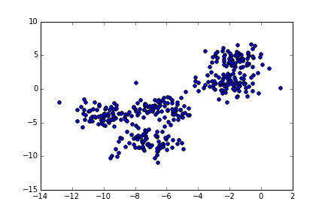
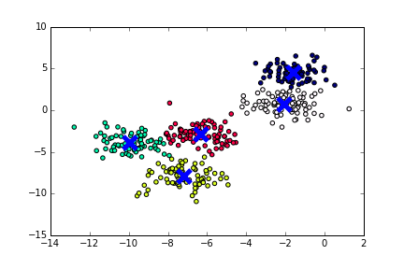
K-Means clustering

Slide 17
K-Means clustering
User must provide the number of clusters
How?
Compute distance of each point to the closest cluster center
Compute the sum of distances
K=1 cluster
Everyone is far away from center
Sum of distances is large
The center is not a good representation of the points
K=1 clusters centers

Slide 18
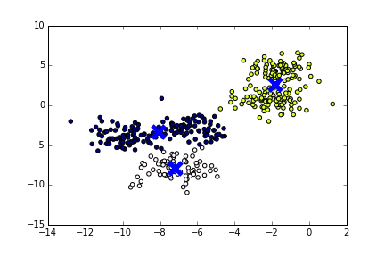
K-Means clustering
User must provide the number of clusters
How?
Compute distance of each point to the closest cluster center
Compute the sum of distances
K=3 clusters
Each point is close to a merged center
Sum of distances decreases
but still large
K=3 clusters centers

Slide 19
K-Means clustering
User must provide the number of clusters
How?
Compute distance of each point to the closest cluster center
Compute the sum of distances
K=5 clusters
Each point is close to their true center
Sum of distances decreases even more
K=5 clusters centers

Slide 20
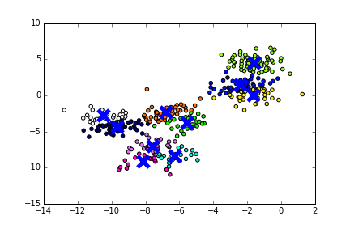
K-Means clustering
User must provide the number of clusters
How?
Compute distance of each point to the closest cluster center
Compute the sum of distances
K=10 clusters
True clusters get split
Sum of distances decreases
but not by a lot, if the clusters were “tight” anyway
K=10 clusters centers

Slide 21
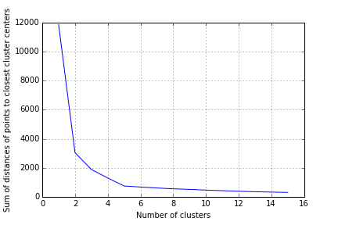
K-Means clustering
User must provide the number of clusters
How?
Choose the point at which the plot flattens out
Knee of the plot

Slide 22
Summary
Clustering (or unsupervised learning)
Group points given only their features X
No class labels y
K-Means
Associates each cluster with a cluster center
Center = the average of all points in the cluster
Uses Euclidean distance to compute closest center

